Slide 2
2026/02/28 20:45 P.M.
UNIX TIMESTAMP: 1772282726
2026/02/28 20:45 P.M.
UNIX TIMESTAMP: 1772282725
2026/02/28 20:45 P.M.
UNIX TIMESTAMP: 1772282724
2026/02/28 20:45 P.M.
UNIX TIMESTAMP: 1772282723
Notes:
用動畫做時間流動的效果

Slide 3

1. 目標

Slide 4
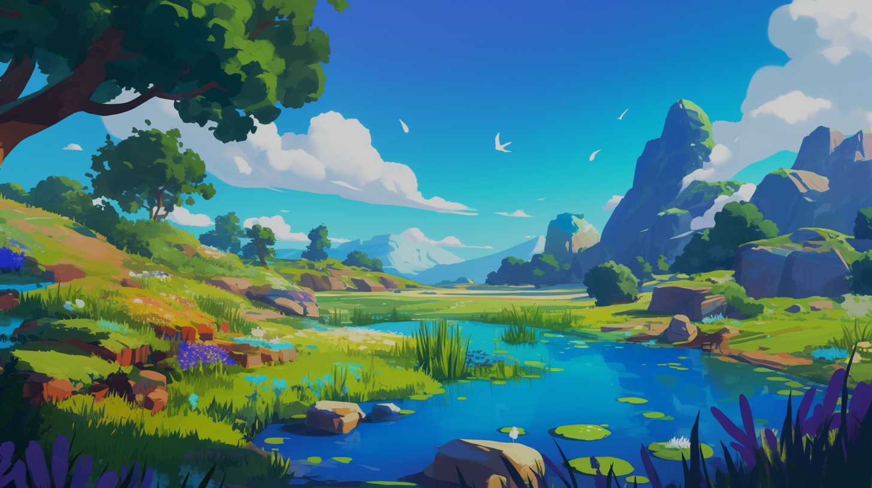
1. 目標

Slide 5
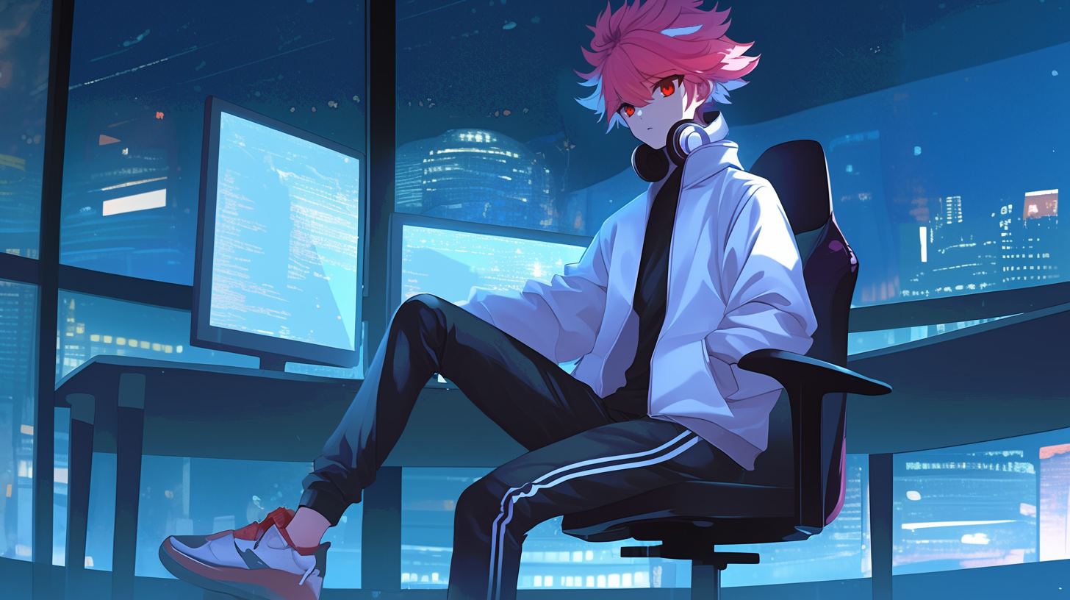
1. 目標
Notes:
同Clip01
使用Midjourney的niji6模型
先前已先詠唱人設三視圖：https://drive.google.com/file/d/1-Z3KBNXPKjodI1RaDnBIXdTAv5i3gkcb/view?usp=sharing
人設三視圖是慢慢用Region Vary修的，基本Prompt:
A 23-year-old boy game developer character, height 180cm with balanced proportions typical of an adult male, slightly dark-pink hair with a handful of blue highlight in the bangs, deep red eyes, wearing gray-white wireless headphones around the neck, Genshin Impact style. Displayed on a single canvas with three distinct, full-body views: 1) complete front view, 2) complete side view, and 3) complete back view. Each view should show the entire figure, full body in all views, clean white background, highly detailed, character design, 4K, UHD quality --no backpack, cropped views --niji 6 --ar 67:71
此張圖Prompt:
the boy in front of computer to coding, boy look on monitor, time is night, only one person --cref <把角色三視圖丟進去後，取得圖片網址，在此填入做為參考> --niji 6 --ar 16:9
Region vary圈選脖子處，讓他戴上耳機的Prompt:
the boy is hanging the headphone on the neck, whole gray headphone

Slide 6
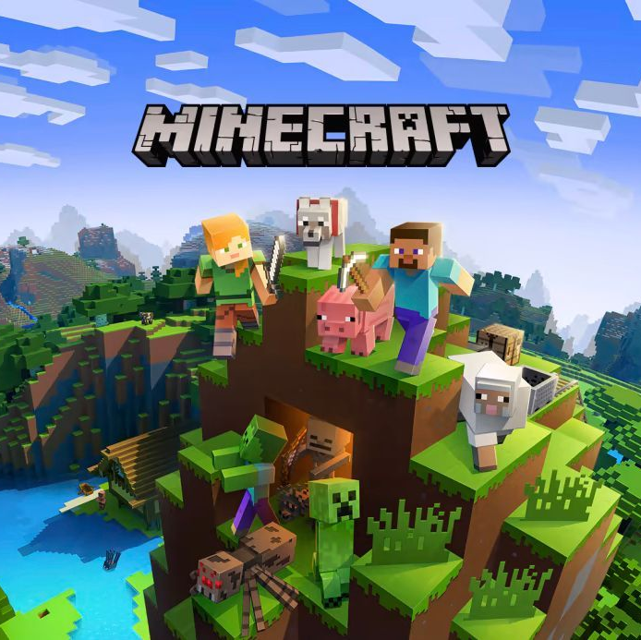
最改變人生的遊戲：《Minecraft》
2. 阻礙

Slide 7

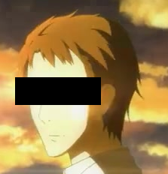
《刀劍神域》
我也想成為茅場晶彥
2. 阻礙

Slide 8
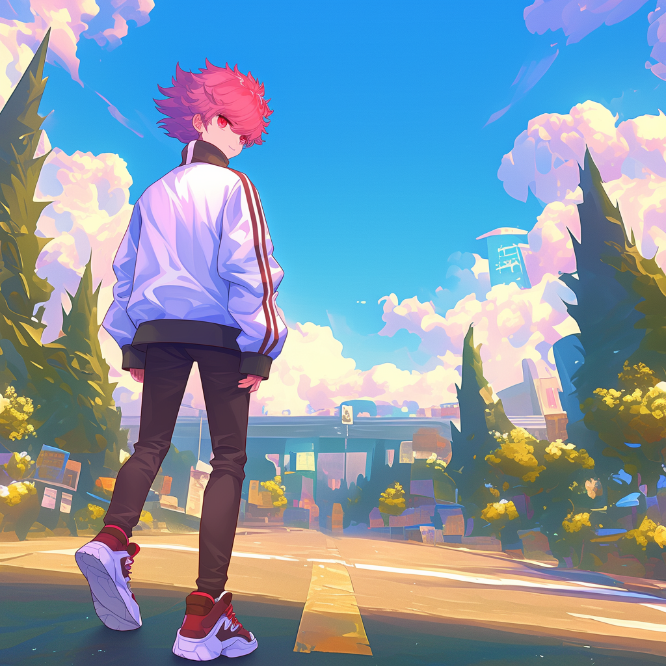
2. 阻礙
Notes:
使用Midjourney的niji6模型
有將自己的人設圖片餵給AI參考
Prompt:
candid photograph, A character walking on road in a game level scene, stylized 2D:2 world with fantasy elements. The character is not looking at the camera, facing away with their back towards the viewer. Hyper-detailed, stylized art, vibrant colors, cinematic lighting, and wallpaper quality. --cref https://s.mj.run/oP4BV2XKGOU --no eye to camera, face to camera, cowboy shot --niji 6 --ar 1:1

Slide 9
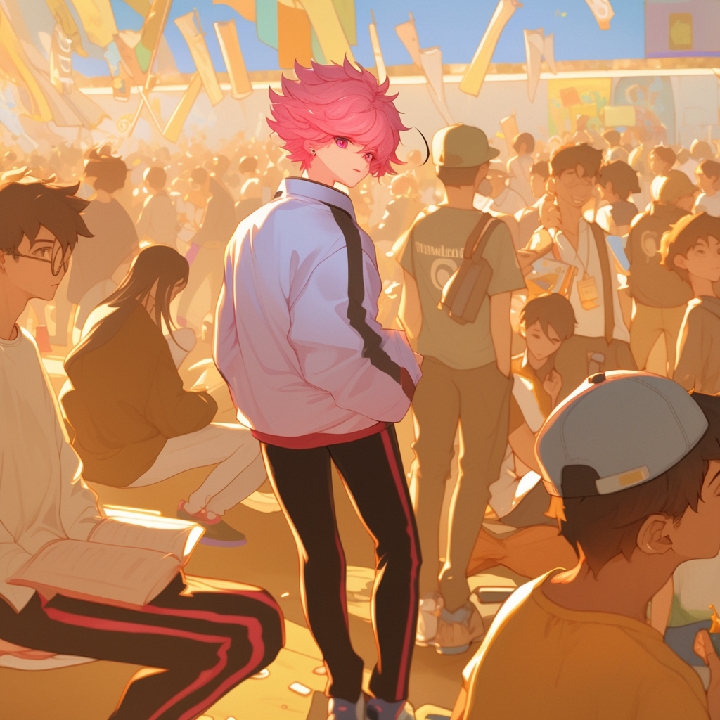
3. 努力
Notes:
使用Midjourney的niji6模型
先詠唱一個畫面
Prompt:
A boy participating in an exchange event surrounded by many people. The people around him look different, some are reading books. The atmosphere is diverse and engaging. anime style --niji 6 --ar 1:1
再將主角圈起來Region Vary，再將自己的人設圖片餵給AI參考做修改

Slide 10
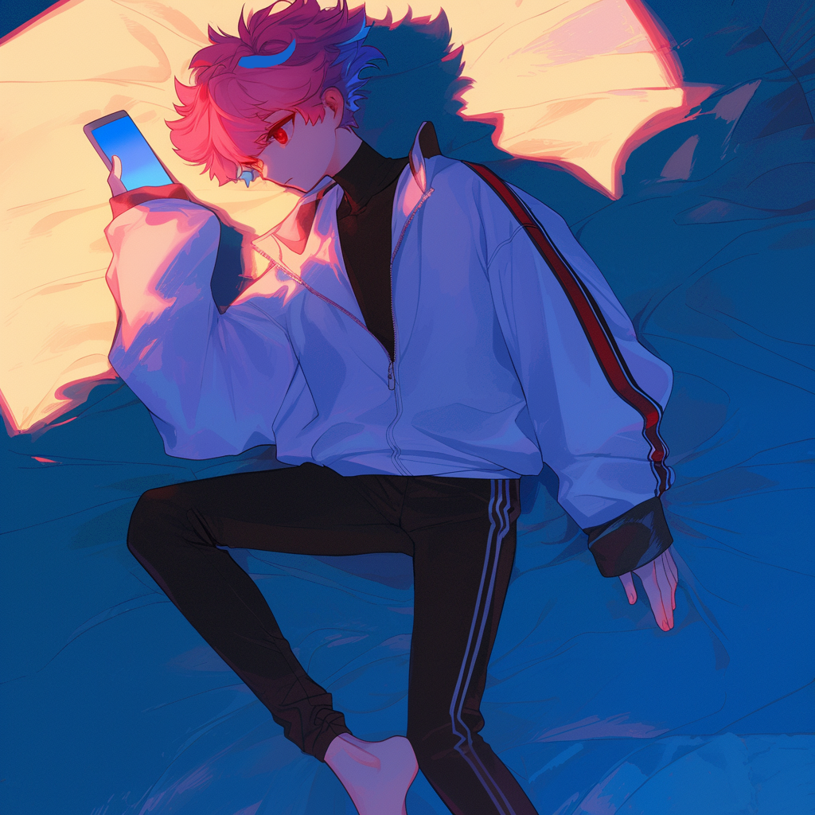
4. 結果
Notes:
使用Midjourney的niji6模型
有將自己的人設圖片餵給AI參考
Prompt:
lose-up shot of a boy lying sideways on a bed, looking at his phone with a sense of disappointment, his face reflecting a feeling of being lost or emotionally down. --cref https://s.mj.run/oP4BV2XKGOU --niji 6 --ar 1:1

Slide 11

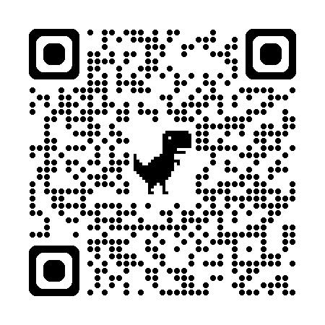
5. 意外
Notes:
https://www.youtube.com/@AoiHinamoriCh

Slide 12
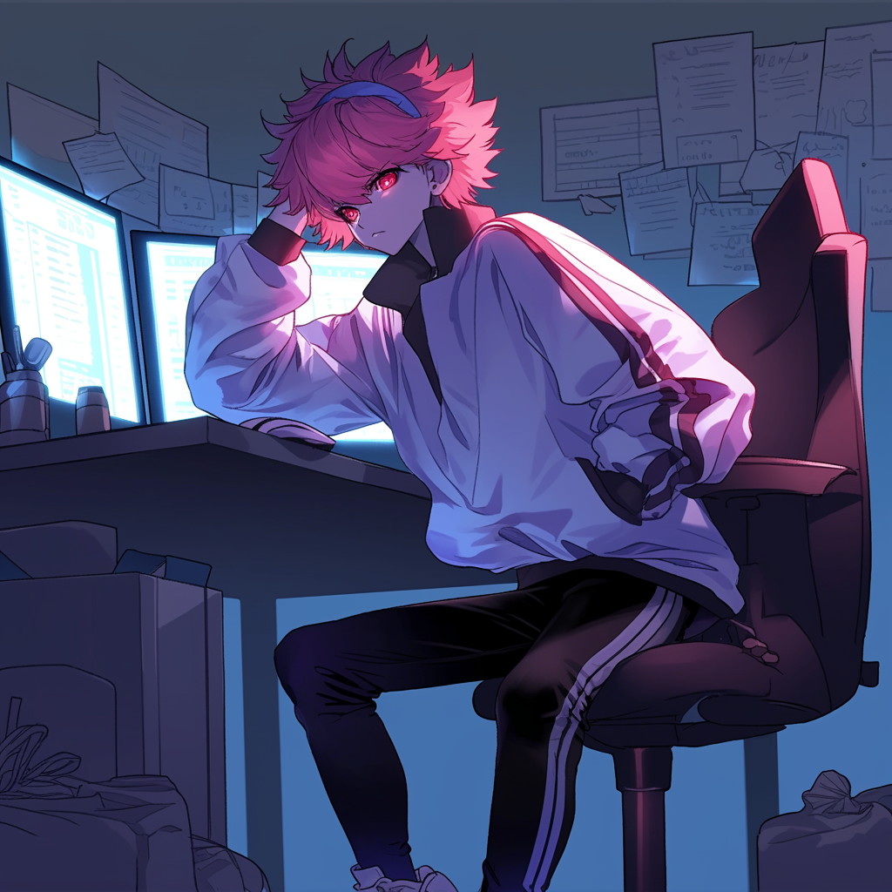
根性
5. 意外
Notes:
使用Midjourney的niji6模型
有將自己的人設圖片餵給AI參考
Prompt:
A determined character sitting at a computer desk, tying a headband around the head with focused determination:2. The character has a resolute expression, symbolizing their comeback and renewed energy. The room is softly lit, filled with technology and a computer screen showing progress. The character’s movement is emphasized, with the headband being securely tied, highlighting the action of preparing for the next challenge with renewed vigor. The scene captures a moment of inspiration and readiness for action. --cref <圖片網址> --ar 1:1 --niji 6

Slide 13
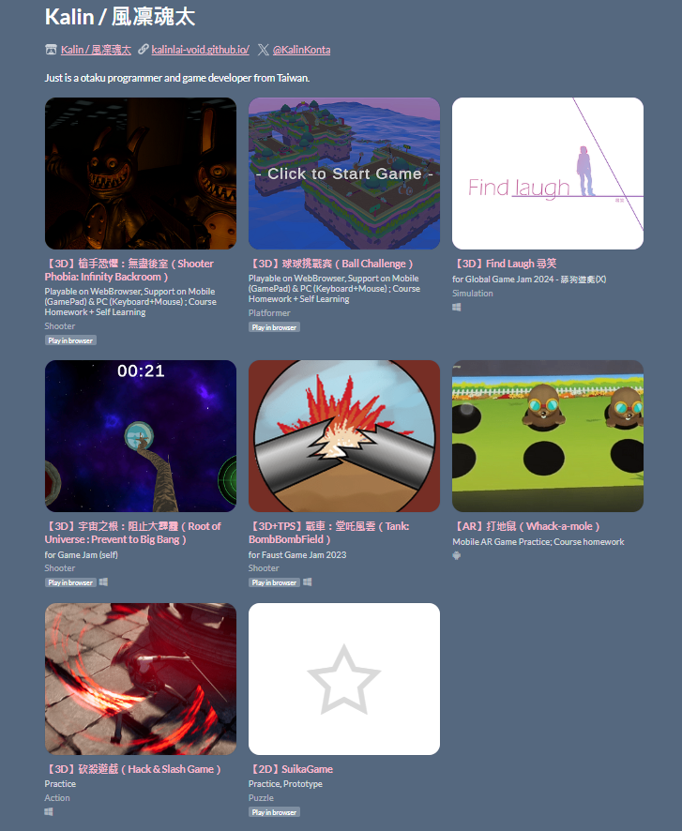
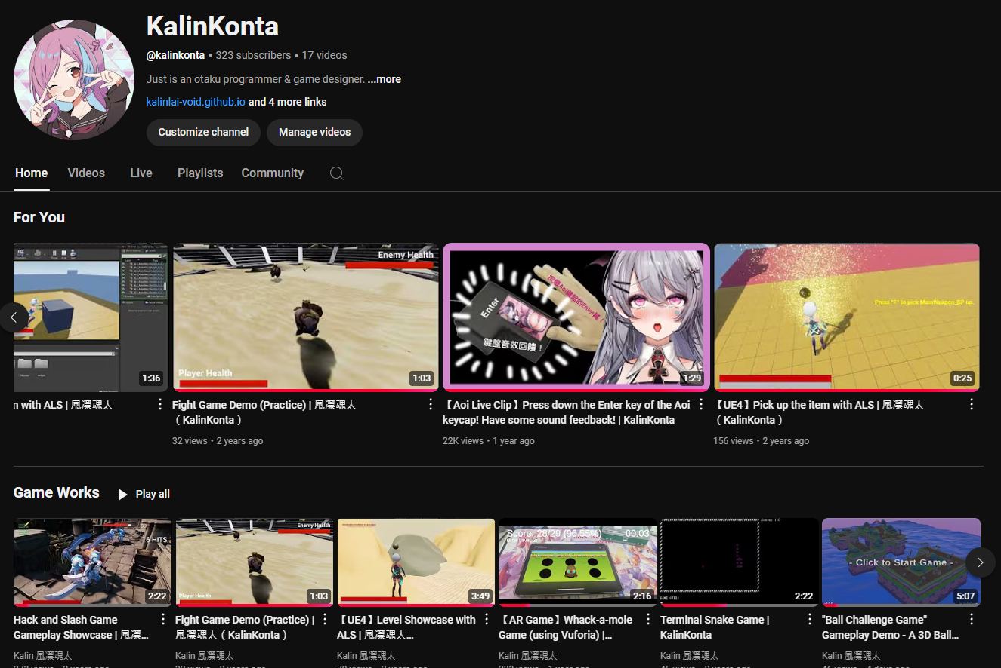
6. 轉彎
Notes:
同Clip01

Slide 14
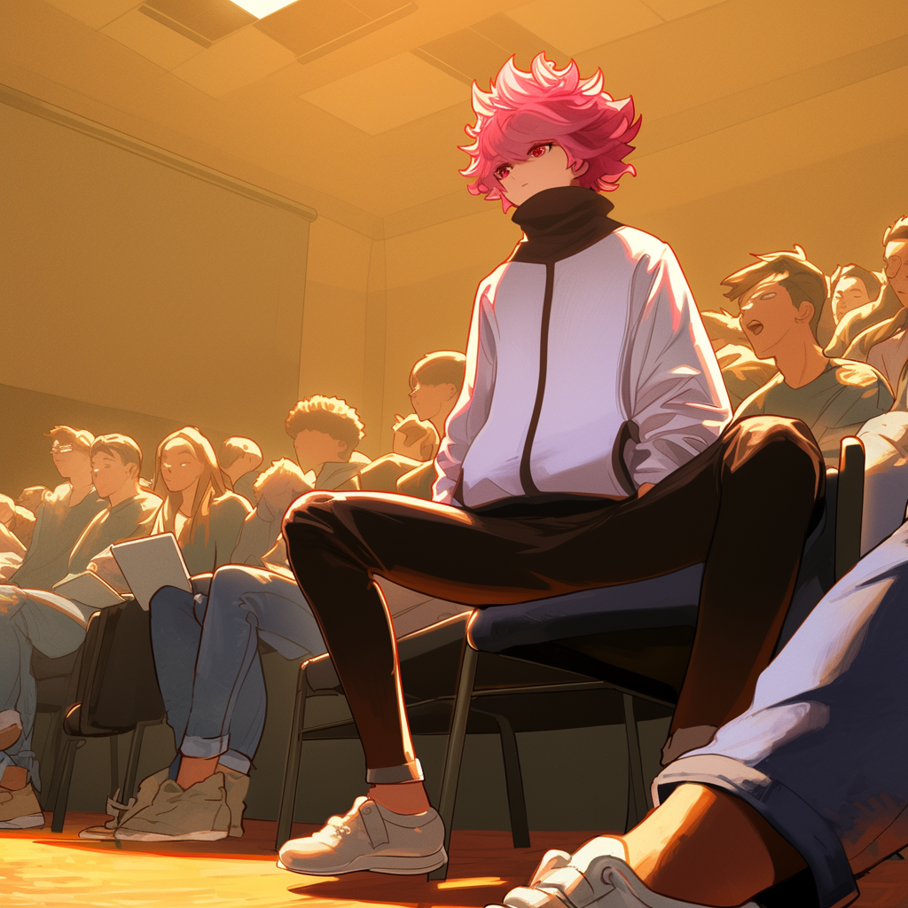
6. 轉彎
Notes:
使用Midjourney的niji6模型
先詠唱一個畫面
Prompt:
An attentive teenage boy sitting in an auditorium, listening to a speaker on stage. He is engaged in discussion with a few people nearby, gesturing thoughtfully. The scene is well-lit, with rows of seats and an audience scattered across the hall. The atmosphere is professional and academic, with a focus on intellectual exchange and learning. The boy wears casual yet tidy clothes, with a notebook or tablet in hand, surrounded by peers of similar age engaged in conversation. anime style --ar 1:1 --niji 6
再將主角圈起來Region Vary，再將自己的人設圖片餵給AI參考做修改

Slide 15
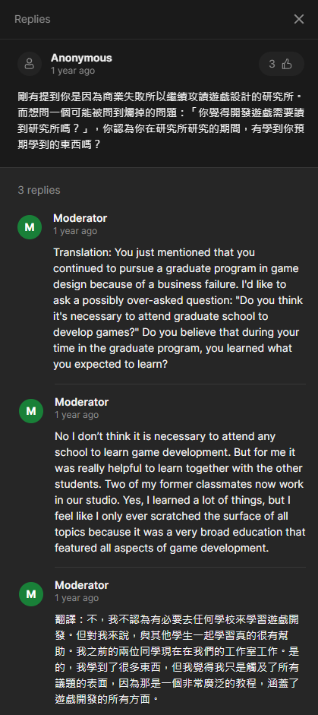
7. 結局

Slide 16
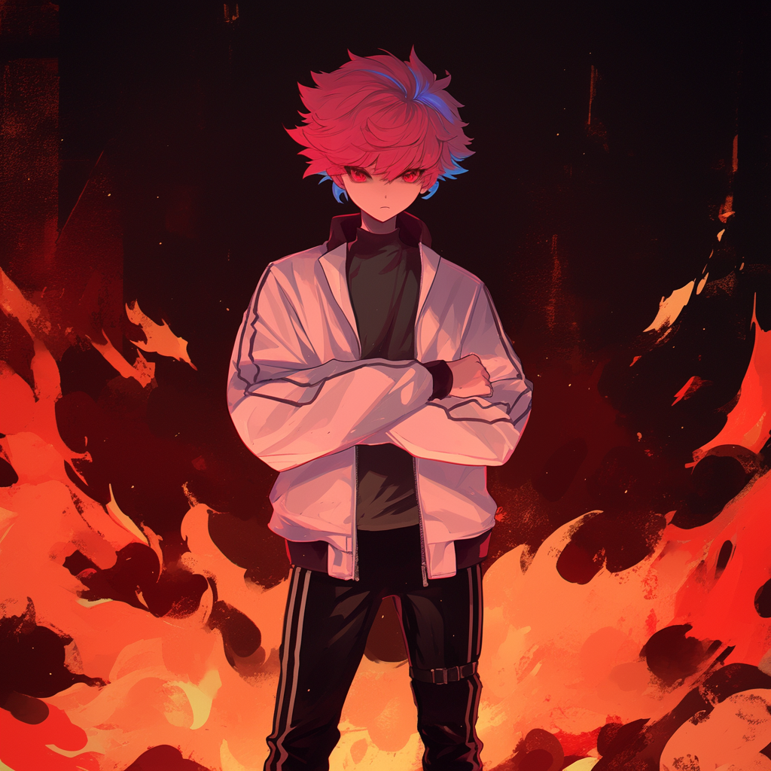
7. 轉彎
Notes:
使用Midjourney的niji6模型
有將自己的人設圖片餵給AI參考
Prompt:
A confident character standing front-facing with arms crossed, wearing a headscarf, flames rising dramatically in the background, dynamic and intense lighting, cinematic composition. --cref <圖片網址> --ar 1:1 --niji 6

Slide 17
7. 結局

